Slide 1
Monolithic Architecture
Pravin Y Pawar

Slide 2
Scenario
Lets say you are developing a server-side enterprise application
Must support a variety of different clients including desktop browsers, mobile browsers and native mobile applications
Might also expose an API for 3rd parties to consume
Might also integrate with other applications via either web services or a message broker
The application handles
requests (HTTP requests and messages) by executing business logic
accessing a database
exchanging messages with other systems
and returning a HTML/JSON/XML response
There are logical components corresponding to different functional areas of the application.

Slide 3
Problem (Forces) and Solution
What’s the application’s deployment architecture?
Forces
A team of developers working on the application
New team members must quickly become productive
Must be easy to understand and modify
Want to practice continuous deployment of the application
Must run multiple instances of the application on multiple machines in order to satisfy scalability and availability requirements
Want to take advantage of emerging technologies (frameworks, programming languages, etc)
Solution
Build an application with a monolithic architecture.
For example:
a single Java WAR file.
a single directory hierarchy of Rails
NodeJS code

Slide 4
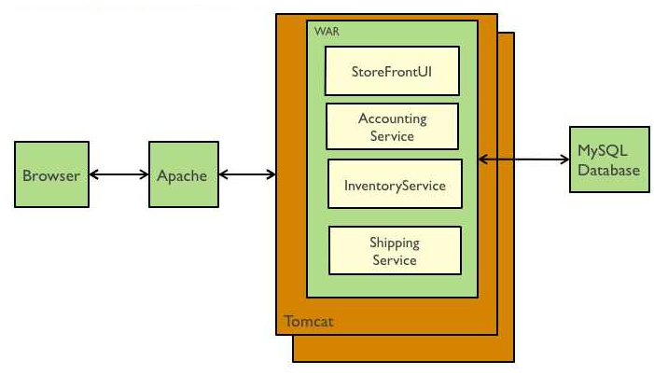
Example
Building an e-commerce application that takes orders from customers, verifies inventory and available credit, and ships them
The application consists of several components including
the StoreFrontUI, which implements the user interface
backend services for checking credit, maintaining inventory and shipping orders

Slide 5
Resulting context
Simple to develop
the goal of current development tools and IDEs is to support the development of monolithic applications
Simple to deploy
simply need to deploy the WAR file (or directory hierarchy) on the appropriate runtime
Simple to scale
can scale the application by running multiple copies of the application behind a load balancer

Slide 6
Thank You!
References:
microservices.io
In our next session:

